Slide 1
Design Key-value database

Slide 2
Table of contents
Key design and partitioning
Designing structured values
Limitation of Key-value database
Design pattern for key-value database
Use cases to use and when not to use

Slide 3
1. Key design and partitioning
﻿How you design your keys can impact the ease of working with your key-value database.
Avoid meaningless name, such as ‘﻿laklsjfdjjd’
Key should have logical structure to make code more readable and extensible, but also be designed with storage efficiency in mind

Slide 4
General guideline to name key
Use meaningful and unambiguous naming components
Use range-based components when would like to retrieve ranges of values
Use common delimiter when appending components to make a key. Normally, use “:” as delimiter
Keep key as short as possible without sacrifice other characteristics mentioned

Slide 5
Keys Must Take into Account Implementation Limitations
Different key-value databases have different limitations. Consider those limitations when choosing your key-value database
Some key-value database restricts size of keys. For example, FoundationDB limits the size of keys to 10,000 bytes

Slide 6
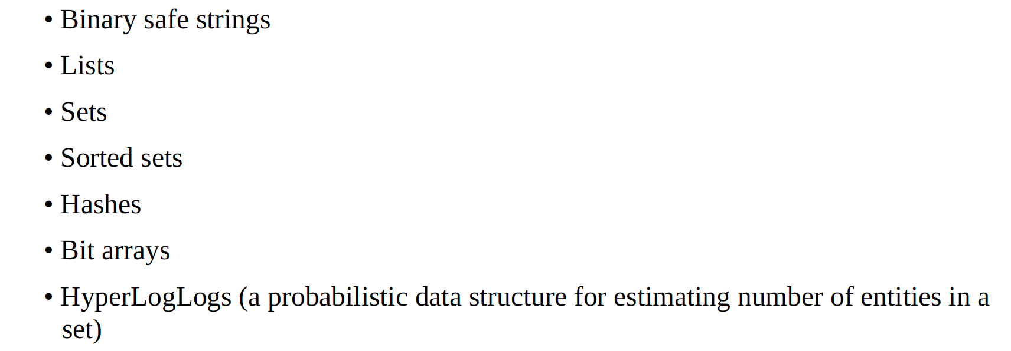
Valid datatypes in Redis

Slide 7
Redis datatypes
The variety of data types supported by Redis allows you more flexibility when creating keys
Redis keys can be up to 512MB in length

Slide 8
How keys are used in partitioning
Key is used in range partitioning
Range partitioning works by grouping contiguous values and sending them to the same node in a cluster
Sort order must be defined over keys. For example, partition by customer number, date, part identifier.

Slide 9
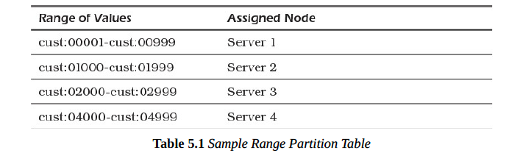
Range partitioning example

Slide 10
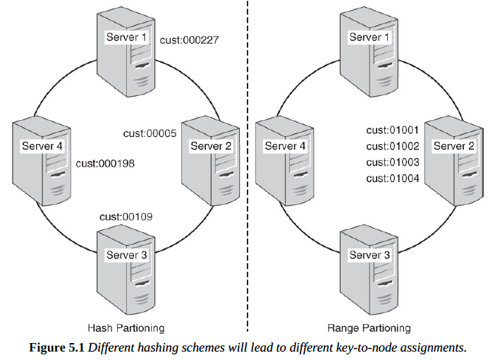
﻿If you decide to use range partitioning, carefully consider how your data volumes may grow. If you need to restructure your partitioning scheme, some keys may be reassigned to different nodes and data will have to migrate between nodes.

Slide 11

2. Designing structure values
Store frequently used values in memory. But it is limited by the amount of room in memory allocated to caching
Store commonly used attribute values together
as this ﻿reduce the number of disk seeks that must be performed to read all the needed data than store name and address separately.

Slide 12
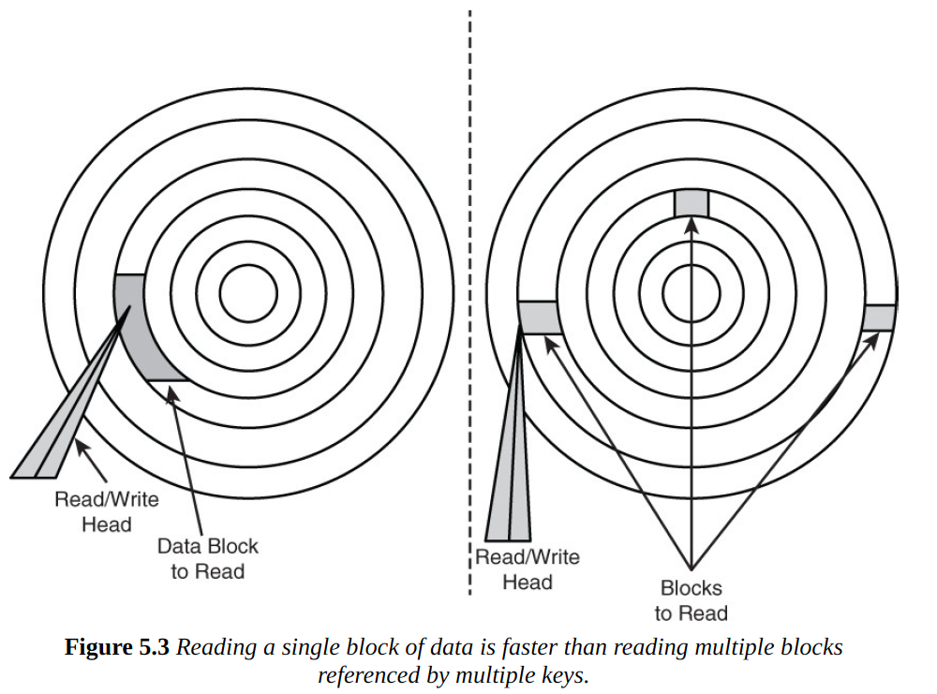

Slide 13
Designing structured values
If customer name is used many times but not the address, store key name separately. ﻿This would duplicate the customer name in your key-value database, but that should not be considered a problem.
However, there are many cases that use only key “name” to lookup name when only that attribute is needed. This is beneficial to our application. Or use key “name” and “address” when name and address are needed.

Slide 14
Large values can lead to inefficient Read/Write Operations
Using structured data types such as lists and sets can improve overall efficiency of applications
﻿It is important to also consider how increasing the size of a value can adversely impact read and write operations
Consider data structure in the next image (don’t do that on your database)

Slide 15
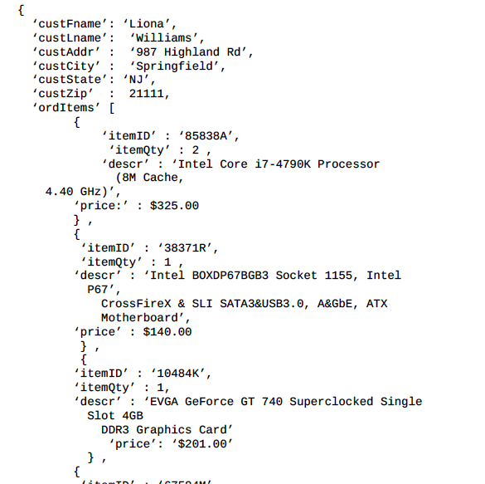
Customer info.
Cart items
﻿Key: ordID:781379
Notes:
This contains user information as well as order information

Slide 16
How this structure is built
When the customer adds her first item to her cart, the list is created and the customer name and address are copied from the customer database.
An order array is created and a list with the item identifier, quantity, description, and price is added to the array. The key value is hashed and the entire data structure is written to disk.
The customer then adds another item to the cart, and a new entry is added to the array of ordered items. Because the value is treated as an atomic unit, the entire list (for example, customer information and ordered items) is written to the disk again.
This process continues for each of the additional items.

Slide 17
Activity: Solution
Can you think of a solution for this problem.

Slide 18
Limitation of key-value
The only way to lookup value is by key: If you want to lookup information in the value, but only using key, this is not convenient.
Some key-value databases do not support range queries. For example: searching data within date range.
There is no standard query language comparable to SQL: Only GET and SET are enough.

Slide 19
3. Key-value considerations aspects
There are some aspects of Key-Value database need considerations
Time to Live (TTL)
Emulating tables
Aggregates
Atomic aggregates
Enumerable keys
Indexes

Slide 20
3.1. Time to live
Is a term to describe a temporary object which has start time and expiration time.
Used in caching data in limited memory server when keys are used to hold a resource for some specified period of time
When current time exceeds expiration time, data will be removed to free memory to store something else.

Slide 21
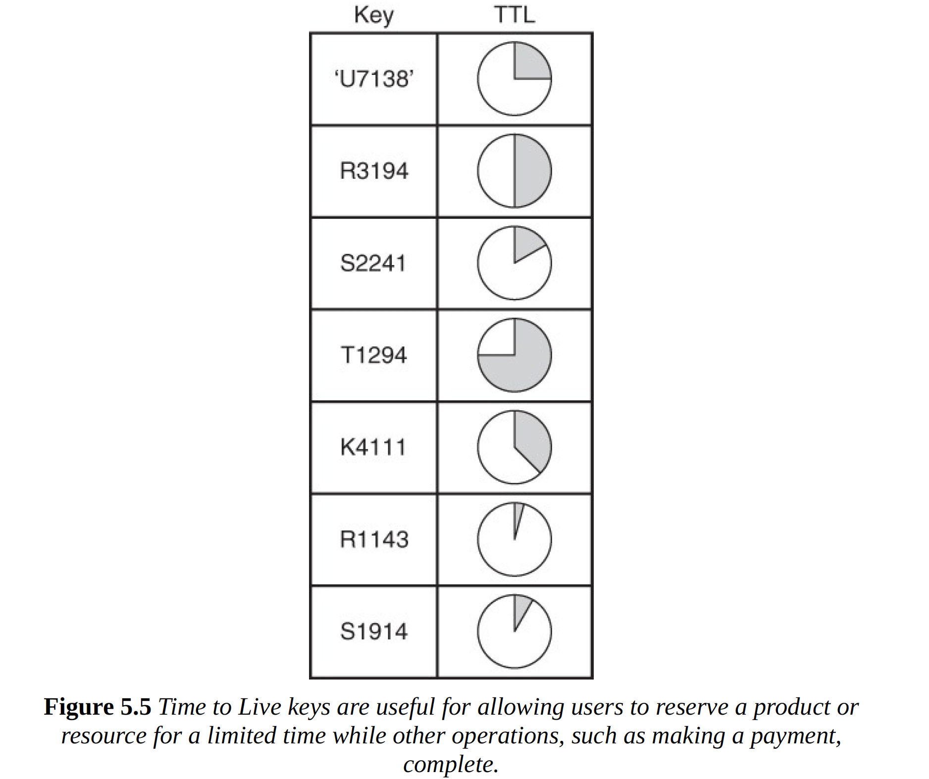

Slide 22
Use cases
In some ecommerce page, there is a function for user to login which stores session in key-value database
Basically, session is created and available in a specific amount of time (2-3 days). After TTL of that key expires, then that key is automatically deleted
Thus, user is signed out.

Slide 23
3.2. Emulating table (Table simulation)
Implement data structure like a table, with only 2 methods SET and GET
Emulating tables streamlines the getting and setting of multiple attributes related to a single instance of an entity, but should not be overused
Frequent use of emulating tables can indicate a misuse of a key-value database
It is helpful when you routinely get or set a related set of attributes. ﻿This pattern is useful when you are dealing with a small number of emulated tables.

Slide 24

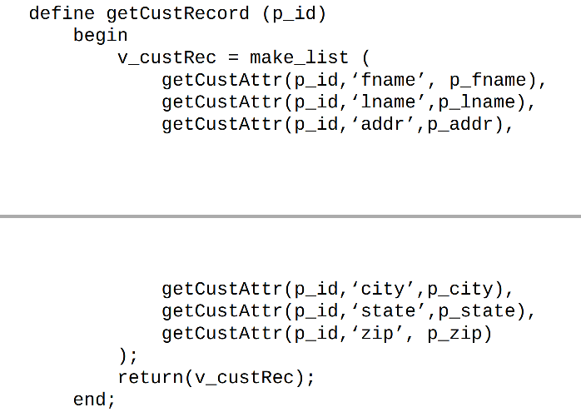
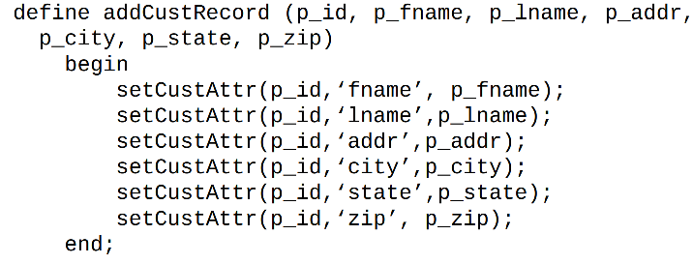
Sample implementation
SET | GET

Slide 25
3.3. Aggregate
Aggregation is a pattern that supports different attributes for different subtypes of an entity
﻿In a relational database, you can handle subtypes in a couple of different ways. You could create a single table with all attributes across all subtypes.
﻿You could also create a table with the attributes common to all subtypes and then create an additional table for each of the subtypes.

Slide 26
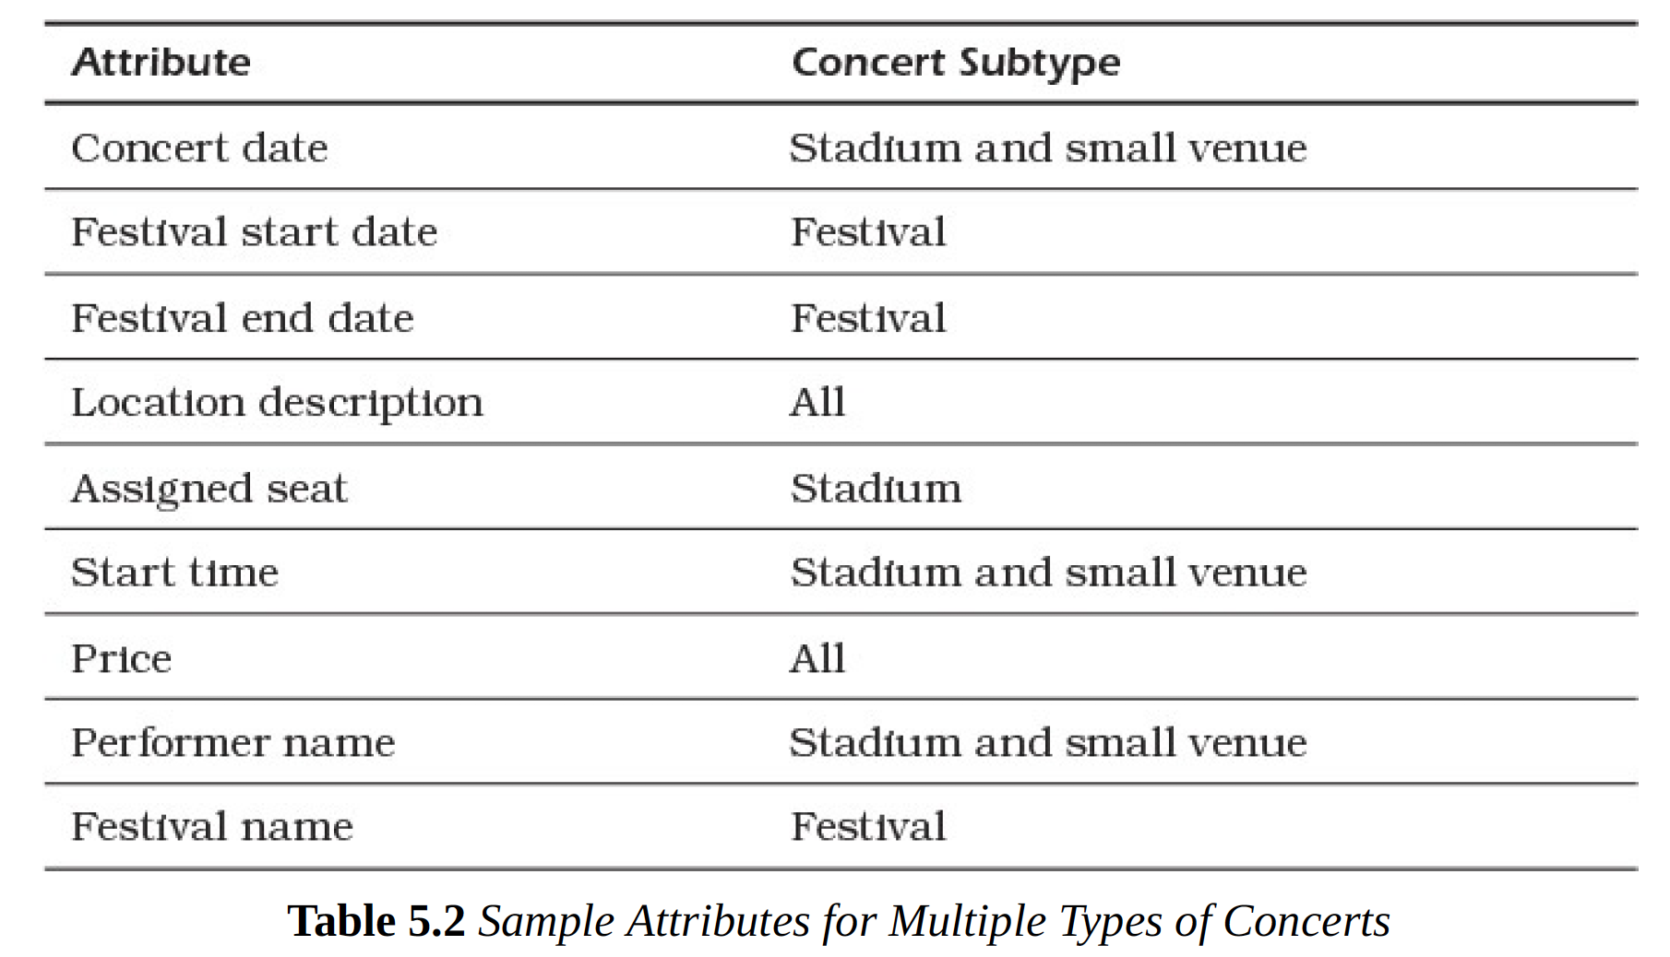
Example data

Slide 27
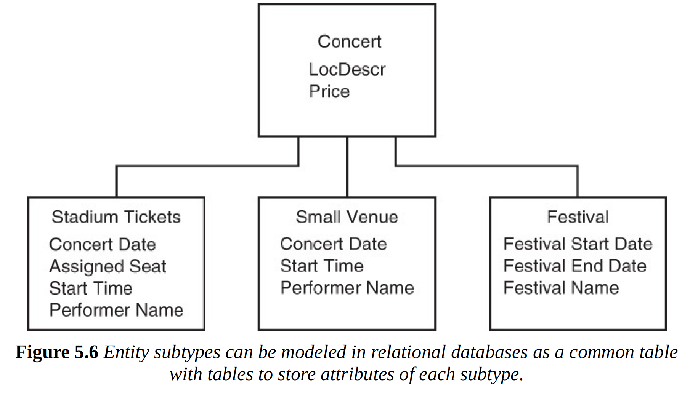
Design in Relational database

Slide 28
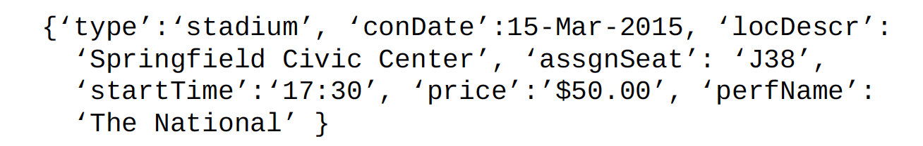
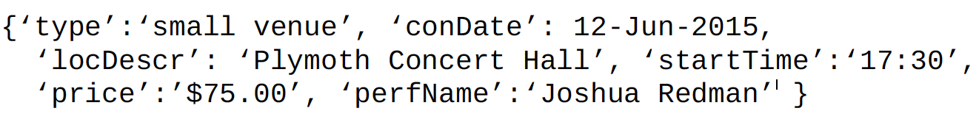
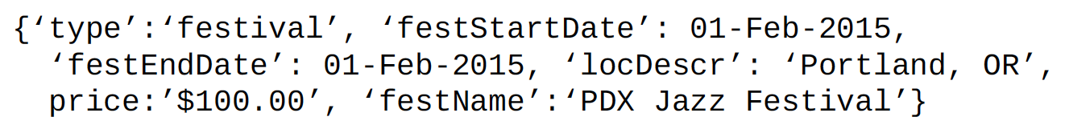
Possible design for child
If it’s stadium
If it’s small venue
If it’s festival

Slide 29
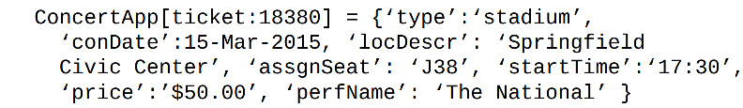
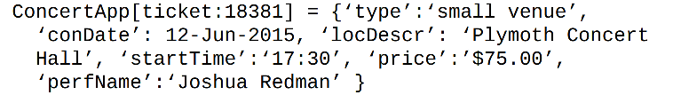
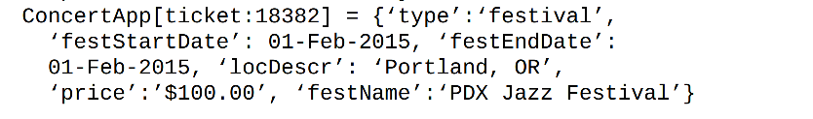
Each of these ticket may be assigned by single namespace such as ConcertApp, such as

Slide 30
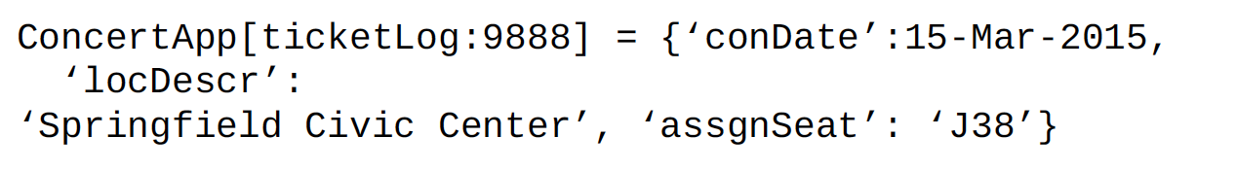
3.4. Atomic Aggregate
Atomic aggregates contain all values that must be updated together or not at all.
﻿The atomic aggregate pattern uses a single assignment statement to save multiple values
﻿For example, if the concert ticket application logged a record each time a stadium ticket is purchased, it should record the date, location, and seat assignment.
This will save all three values or none at all. Critical data will be missed if only 1 attr is saved

Slide 31
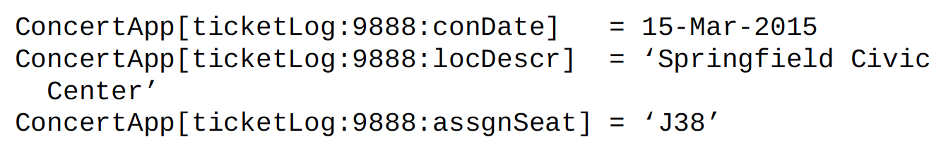
Atomic Aggregate (2)
If trying to log each attribute separately, some attributes will be updated while others are not
The best way is to store all information in a single key
What if the server writing this data to disk failed after writing the locDescr attribute but before writing the assgnSeat attribute, then you would lose a critical piece of data.

Slide 32
3.5. Enumerable Keys
Keys that use counters or sequences to generate new keys
This on its own would not be too useful; however, when combined with other attributes, this can be helpful when working with groups of keys

Slide 33
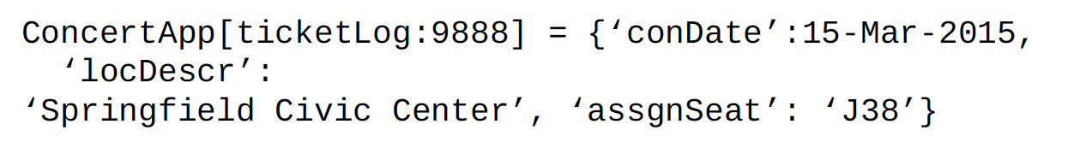
Example
Entity “ticketLog” and counter is used as key
Counter starts at 1 and increases each time a ticket is sold. For example: ﻿'ticketLog:20140617:1', 'ticketLog:20140617:2’, 'ticketLog:20140617:3'
However, with ranged values such as from date… to date…, this key naming convention doesn’t fully function well.

Slide 34
Example (2)
If day is required for logging, then this key format is accepted
20140617: Date sold on June 17th 2014
10: Tenth ticket
Of course, range of tickets can be retrieved by generating series of keys, such as until reaches the number of keys specified

Slide 35
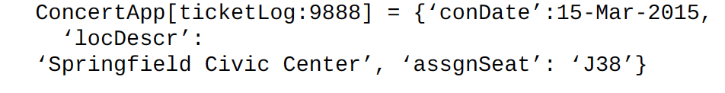
3.6. Index
Inverted indexes are sets of key-value pairs that allow for looking up keys or values by other attribute values of the same entity
For example
This is useful for tracking all seats assigned across concerts, but it is not easy to list only seats assigned in a particular location unless your key-value database provides search capabilities

Slide 36
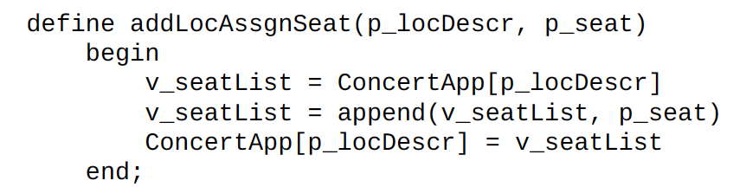
Perform searching
In order to do that, write a function to search by key and if matches, append to the end of list and return result
If the function is initially called as the following,
➔ It would set the value of ConcertApp['Springfield Civic Center'] to {'J38’} and so on with other values

Slide 37
When to use design patterns
﻿The Time to Live pattern is useful when you have operations that may be disrupted and can be safely ignored after some period of inactivity or inability to finish the operation
﻿Emulating tables streamlines the getting and setting of multiple attributes related to a single instance of an entity, but should not be overused. ﻿Frequent use of emulating tables can indicate a misuse of a key-value database
﻿Aggregates provide a means for working with entities that need to manage subtypes and different attributes associated with each subtype.

Slide 38
When to use design patterns(2)
﻿The atomic aggregate pattern is used when you have multiple attributes that should be set together
﻿Enumerable keys provide a crude range functionality by allowing a program to generate and test for the existence of keys
﻿Indexes allow you to look up attribute values starting with something other than a key

Slide 39
5. Common Use-cases of K-V db
Web applications may store user session details and preference in a key-value store. All the information is accessible via user key, and key-value stores lend themselves to fast reads and writes.
Real-time recommendations and advertising are often powered by key-value stores because the stores can quickly access and present new recommendations or ads as a web visitor moves throughout a site.
On the technical side, key-value stores are commonly used for in-memory data caching to speed up applications by minimizing reads and writes to slower disk-based systems.

Slide 40
Common use cases (2)
Queues: Any application that deals with traffic congestion, messaging, data gathering, job management, or packet routing.
Realtime chat messaging: Using Pub/Sub mechanism, 2 people can chat at the same time
Ip address tracking: Redis Sets are a great tool for developers who want to analyze all of the IP addresses that visited a specific website page or blog post
Scoreboards: Redis Sorted Sets to maintain their high score lists, as scores can be repeated, but user details only appear once.

Slide 41
Applications using Redis
Handing user information
Handing user session
Supporting personalization

Slide 42
5.1. Handling user session
Generally, every web session is unique and is assigned a unique sessionId value after user successfully logs in.
Applications that store the sessionId on disk or in an RDBMS will greatly benefit from moving to a Key-Value DB since everything about the session can be stored by a single PUT request or retrieved using GET.
This single-request operation makes it very fast, as everything about the session is stored in a single object as we use in key-value

Slide 43

Example session storage
Store sessionId in key

Slide 44
5.2. High-speed data caching
Should cache data that takes times to complete, or can reuse, instead of querying same data over and over again, such as querying authenticated users info.
High‐speed in‐memory caching provides this caching capability without the need for a separate application level caching layer.
This reduces total cost of ownership and makes developing well‐performing applications quicker and easier.

Slide 45
Supporting personalization
User receives different personalized views of same data from database. These view preferences need to be saved somewhere
No need to store personalization settings in database, it’s specific to frontend application
Using key-value store contains userId and the service allows to store personalization settings as value. This makes system responds very quick and prevent slow performance.

Slide 46
Example personalization storage
User:<userId>:preferences = {
item_per_page: 10,
theme: light,
notifications: {
comments: [‘push’, ‘email’, ‘sms’],
tags: [‘push’,’email’, ‘sms’]
}
…
}
Since preferences are read very frequently on each request. Using Redis cache, user preference can be easily stored and retrieved. No need to query RDBMS each time page is loaded

Slide 47
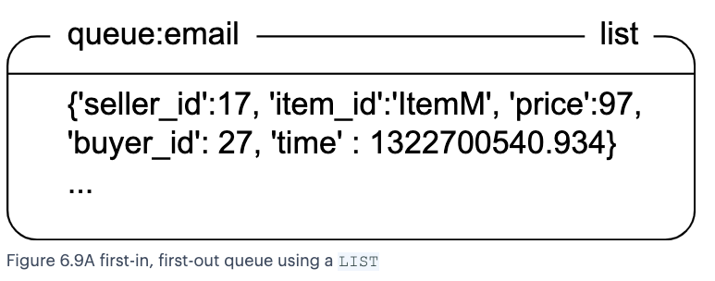
Redis use case: Queues
Send email to all subscribers. We can use queue to handle sending email for each person who subscribed.
Each time user subscribed to a channel, a new user data will be serialized and will be recorded to Redis and DB for persistent by appending to the end of LIST using RPUSH. After sending email, LPOP user that has been sent.

